Slide 1
TA session 10 - 01.01.2020
Exam 2
Hough Transform
Color

Slide 2
Exam 2

Slide 3
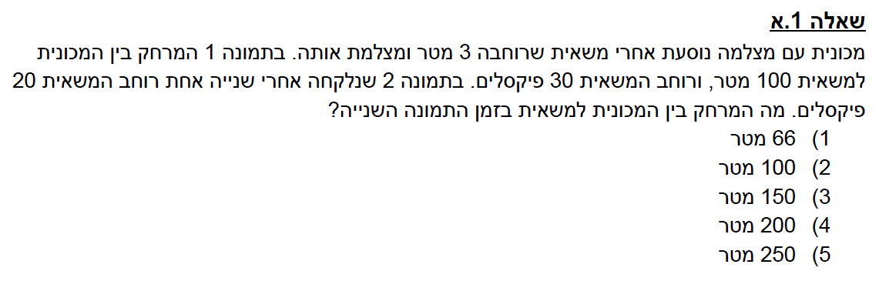

Slide 4
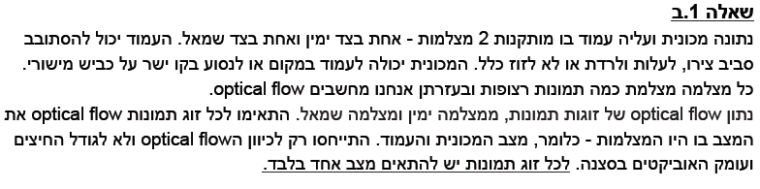


Slide 5
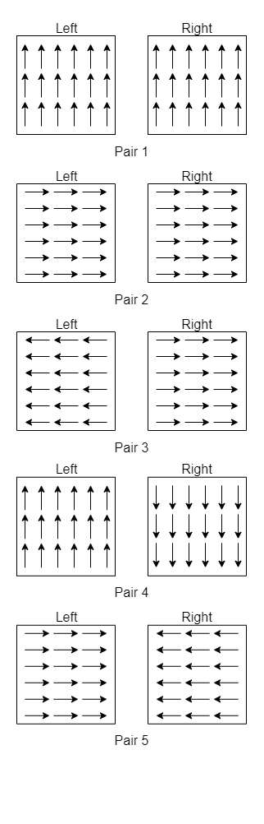

Slide 8
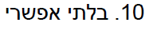

Slide 10
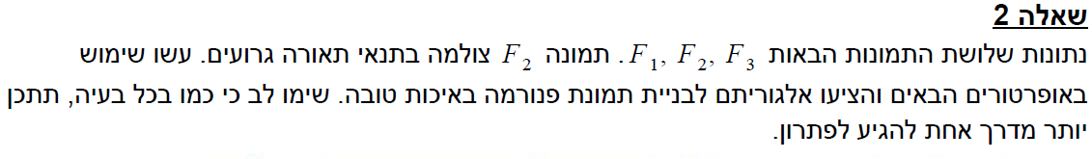
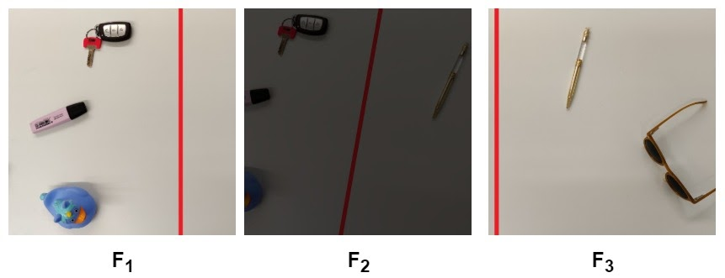

Slide 11
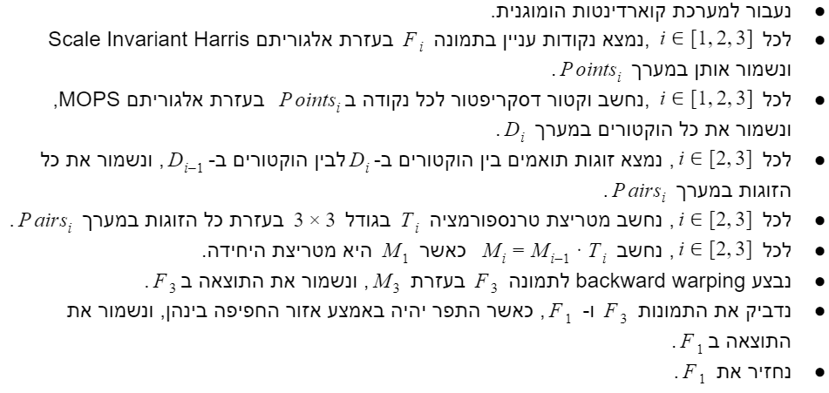

Slide 12
Hough Transform

Slide 13
Hough Transform
(proposed by Hough in 1959 for the analysis of bubble chamber photographs)
Finding Shapes
• Straight Lines
• Rectangles
• Circles
• etc.
More generally
The Hough Transform is a voting scheme on shape parameters.
13

Slide 14
Applications
Find signs in an image (detect rectangles, circles).
3D reconstruction of buildings (detect façade lines).
Find the eye in a face image, a ball in a scene.
More…
The challenge:
The image usually contains lots of irrelevant information (edges unrelated to the shape or due to noise).
There are partial occlusions.
14

Slide 15
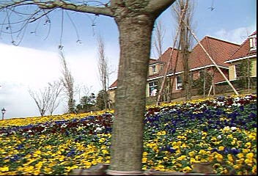
15

Slide 16
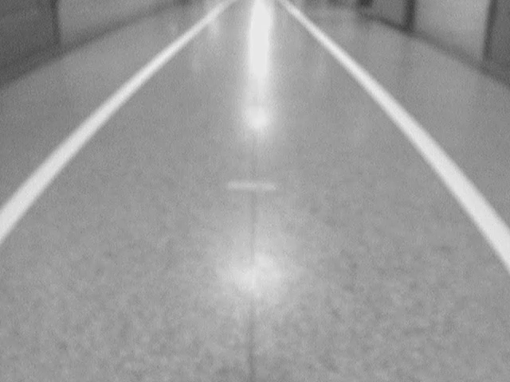

How can we detect lines from edge images?
Raw Image
Edge Image
16

Slide 17
How can we detect lines from edge images?
Given an edge image, we would like to group sets of edge pixels to identify dominant lines in an image.
One possibility is to perform template matching in the edge image
Generate a hypothetical line “kernel” and convolve with the image
Requires a large set of masks to accurately localize lines, which is computationally expensive
We will instead perform an edge image transformation where edge pixels vote for possible lines
Eventually reduces the problem to vote thresholding
17

Slide 18
The parameter space
The line equation in slope-intercept representation:
y = ax + b
Lines can be represented with the 2 parameters (a, b).
y = 2x + 3
Parameter space
Image
b
y
a
x
18

Slide 19
The parameter space
The line equation in slope-intercept representation:
y = ax + b
Lines can be represented with the 2 parameters (a, b).
If we define a 2D parameter space, each line is mapped to a single point in this space.
19

Slide 20
The parameter space
For each point (x, y) in the image there are infinite number of points (a, b) passing through:
y = ax + b
Image
b = -xa + y
y
x
20

Slide 21
The parameter space
For each point (x, y) in the image there are infinite number of points (a, b) passing through:
b = -xa + y
For Example:
(x,y) = (6,8)
b = -6a+8
And this is a line
21

Slide 22
The duality property
A point is mapped to a line, and a line is mapped to a point.
Hough
Image
b
y
a
x
Hough
Image
How can
we use this
duality?
b
y
a
x
22

Slide 23
Hough Transform: use a voting scheme
Apply an edge detector on the image (gradient + threshold, or using Canny’s method)
Prepare a table h(a,b) for a,b in a certain range.
Loop over the image: for each pixel (x,y) on an edge, vote for all the cells (a,b) which satisfy the equation: y = ax + b (meaning, increase the cell counter: h(a,b)++ )
Choose the cell having maximal value (or the cells which pass a given threshold)
23

Slide 24
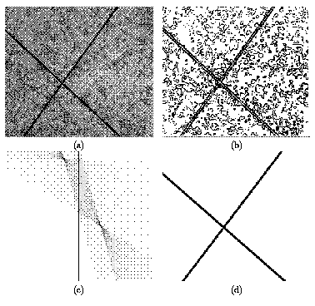
Example: Slope-intercept representation
Original image
Edge Map
Take two strongest lines
Hough
(before threshold)
24

Slide 25
Issues to consider…
Representation: Vertical lines are not covered by the representation y = ax+b.
Range: Selecting the range of values for the table
Quantization: choosing a grid.
25

Slide 26
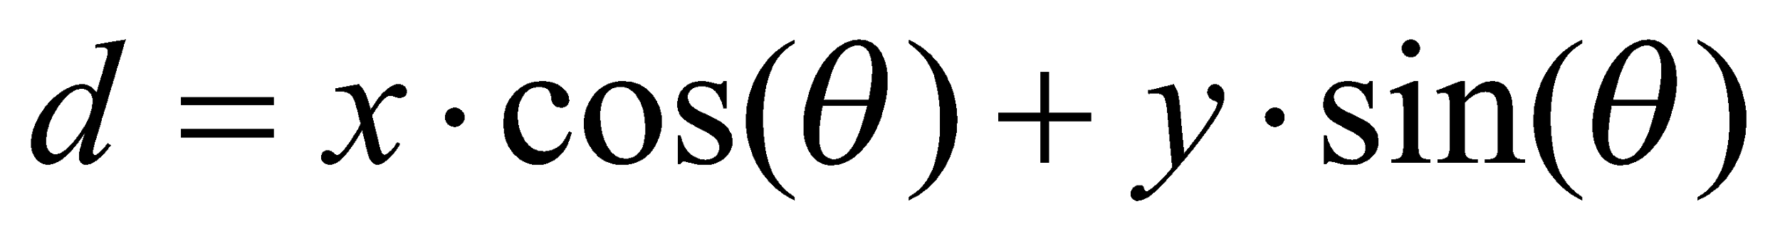
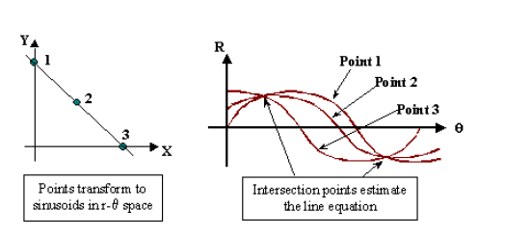


A better representation
Use a polar representation instead:
d - The distance from (0,0)
- Angle relative to x axis
d
d
26

Slide 27
A better representation
Use a polar representation instead:
d - The distance from (0,0)
- Angle relative to x axis
Hough
Image
d
y
θ
x
27

Slide 28
Polar representation
d
28

Slide 29
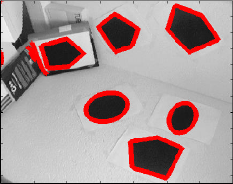
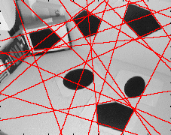
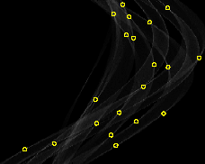
Polar Representation Example
1. Original image + edges
3. Image + detected lines
2. Hough
29

Slide 30
Range and Quantization
In the polar representation it is easier to determine the range:
The values of d and of θ are bounded.
The resolution can be application dependent.
There are natural units for the grid spacing (pixels for d and degrees for θ)
Quantization:
Option 1: Vote to the “nearest” cell – for each θ take the nearest d.
Option 2: Perform a weighted vote.
30

Slide 31
Smoothing
Hough
Image
Without smoothing
b
y
a
x
Hough
Image
With smoothing
b
y
a
x
31

Slide 32
Making the Decision
Q: How can we find the two most dominant lines in the image ?
The problem: if (r,θ) is the cell with the maximal value, then (r+ε, θ +ε) also gets a high scores.
Solution: search only for local maxima.
32

Slide 33
Using more image features.
Example – using the local gradient
Hough
Image
without gradient
b
y
a
x
Hough
Image
using gradient
b
y
a
x
33

Slide 34
Using more image features.
Example – using the local gradient
Hough
Image
without gradient
b
y
a
x
Hough
Image
using gradient
b
y
a
x
34

Slide 35
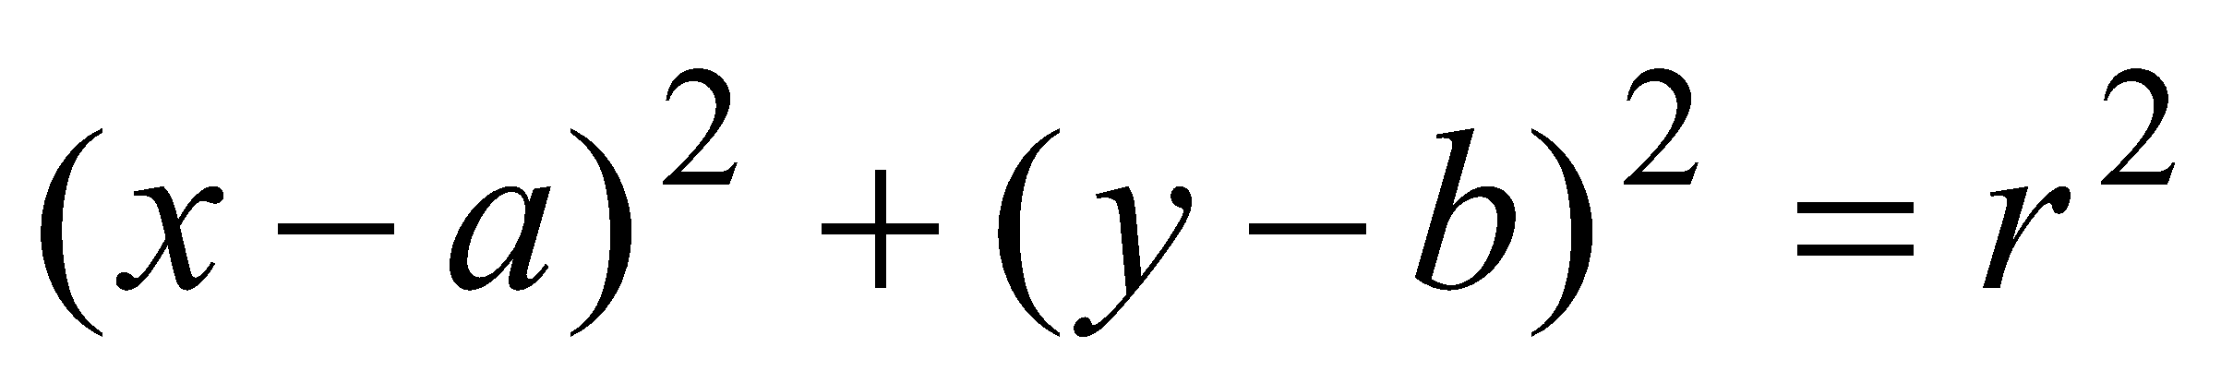
Detecting Complex Shapes – Circles
Naïve solution:
Construct a table h(a,b,r).
For each pixel (x,y) which is an edge in the image, vote for all the cells satisfying:
Problem:
The size of the table is O(N³).
The voting for each pixel takes O(N²).
Solution: Use the gradient information
Vote only to centers (a,b) in the gradient direction
Advanced: vote with complex numbers
35

Slide 36
Circle Example
With no orientation, each token (point) votes for all possible circles. With orientation, each token can vote for a smaller number of circles.
36

Slide 37
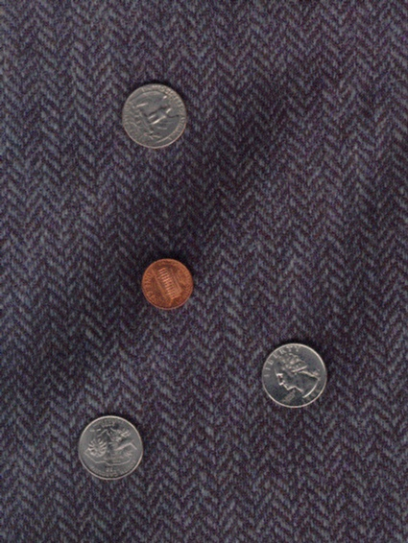
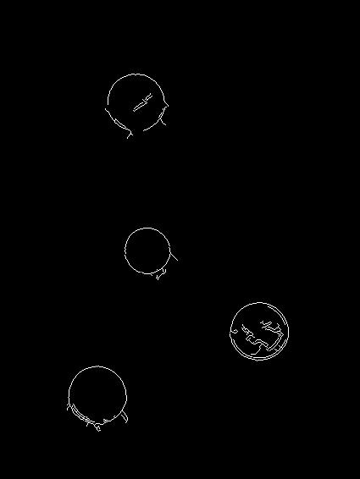
Finding Coins
Original
Edges (note noise)
37

Slide 38
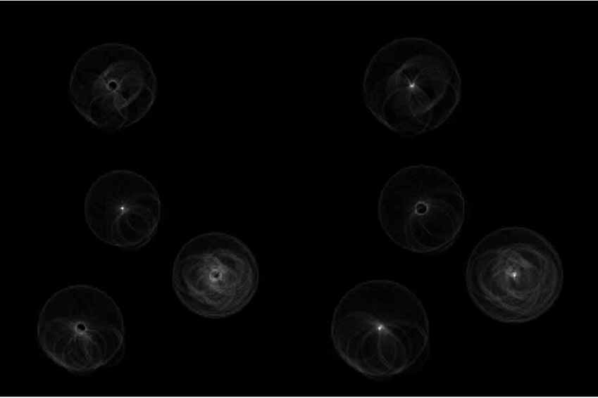
Finding Coins (Continued)
Penny
Quarters
38

Slide 39
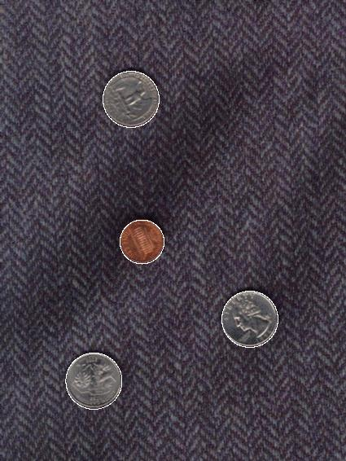
Finding Coins (Continued)
Note that because the quarters and penny are of different sizes, a different Hough transform (with separate accumulators) was used for each circle size.
Coin finding sample images from: Vivik Kwatra
39

Slide 40
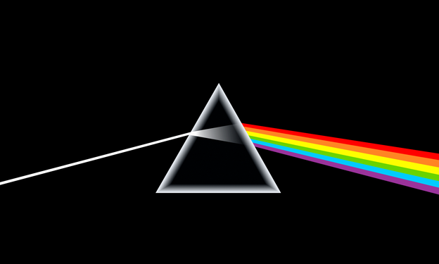
color

Slide 41
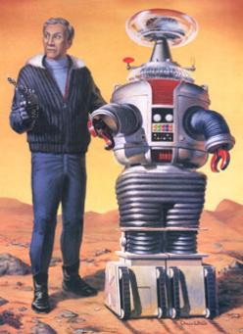
Why does a visual system need color?
http://www.hobbylinc.com/gr/pll/pll5019.jpg

Slide 42
Why does a visual system need color?
A very incomplete list:
To tell what food is edible.
To distinguish material changes from shading changes.
To group parts of one object together in a scene.
Check whether a person’s appearance looks normal / healthy.
...

Slide 43
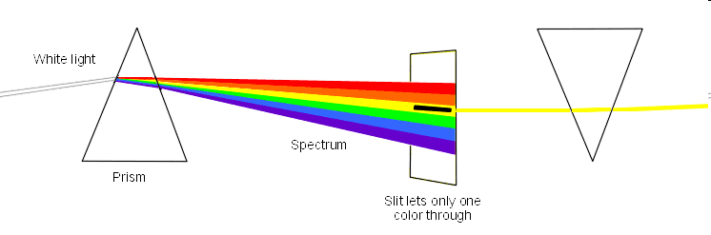
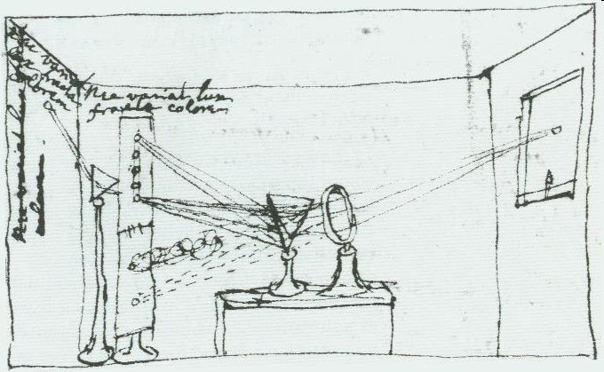
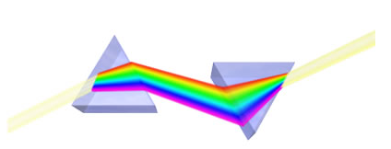
Newton’s prism experiments (1666)
1. Sunlight decomposition into fundamental components:
2. Recovering sunlight with another prism:
Newton’s sketch of 1,2
Figures from:
http://www.departments.bucknell.edu/History/Carnegie/newton/refraction.html
http://astrophys-assist.com/educate/solarobs/ses01p02.htm
http://www.bio.indiana.edu/~cryo/eftem.html

Slide 44
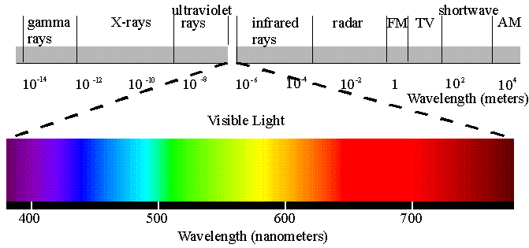
Spectral colors
The electromagnetic spectrum and the visible spectrum:

Slide 45
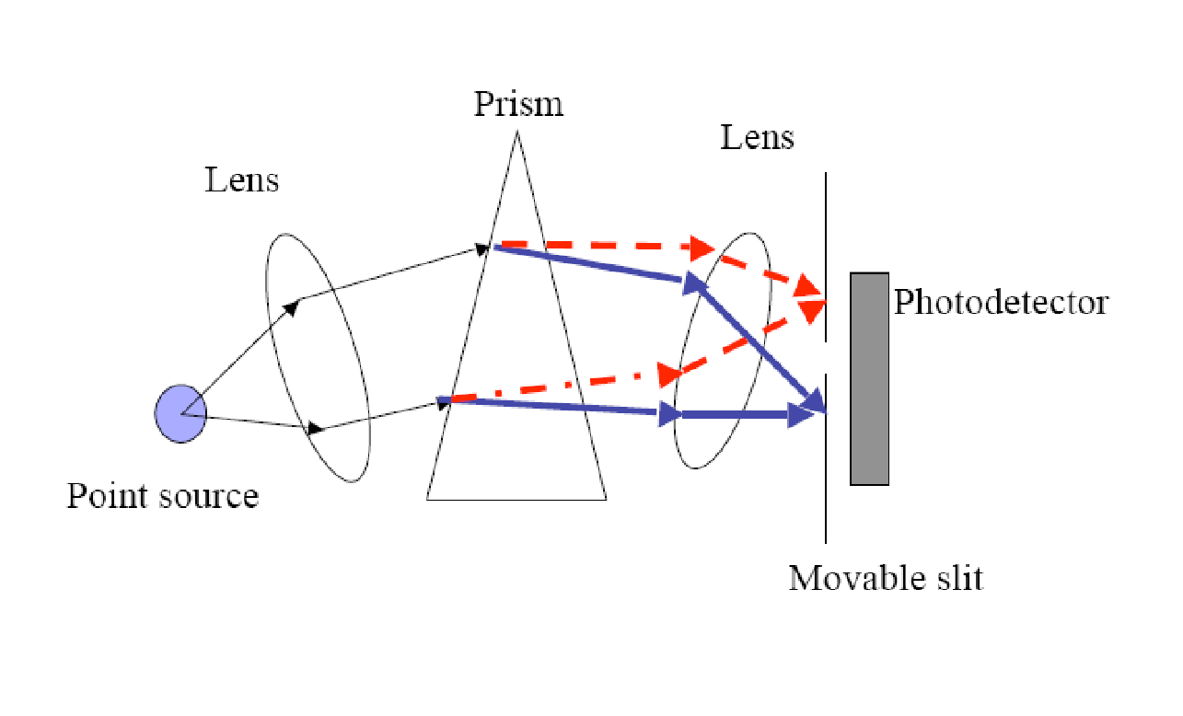
Measuring the spectrum of a light source
Spectroradiometer
(Just like Newton’s diagram…)
Foundations of Vision, by Brian Wandell, Sinauer Assoc., 1995

Slide 46
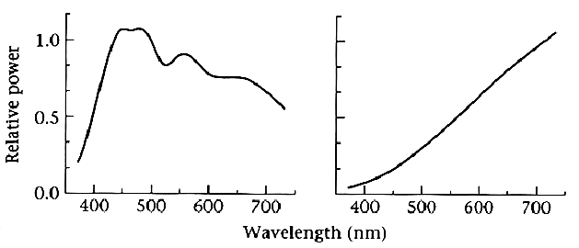
Two illumination spectra
Blue Skylight
Tungsten Light Bulb
Foundations of Vision, by Brian Wandell, Sinauer Assoc., 1995

Slide 47
Human Color Vision
Two types of cells that responsible to our vision.
Rods - “intensity” receptors. Very insensitive. Responsible for night vision. 125 million. Peripheral vision.
Cones – “color” receptors. 3 types of cones (red, green, blue). 4.5 million. Densely packed at the retina.
The information from rods and cones (“color” receptors) is integrated through connections between nerve cells in the retina.
Foundations of Vision, by Brian Wandell, Sinauer Assoc., 1995

Slide 48
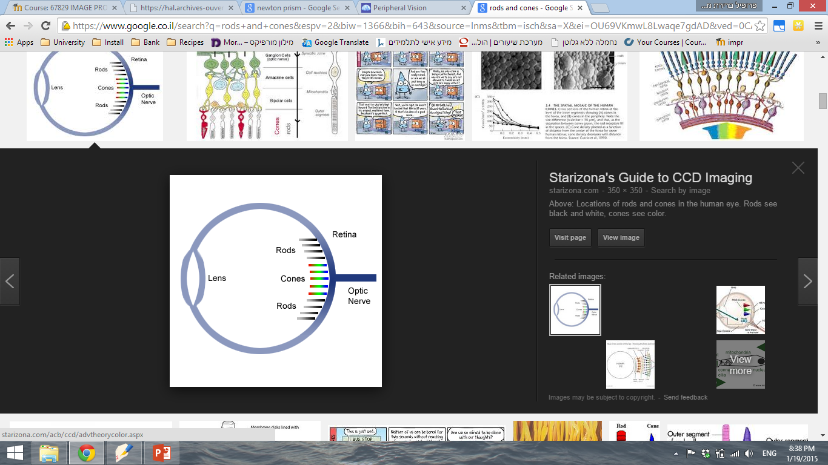
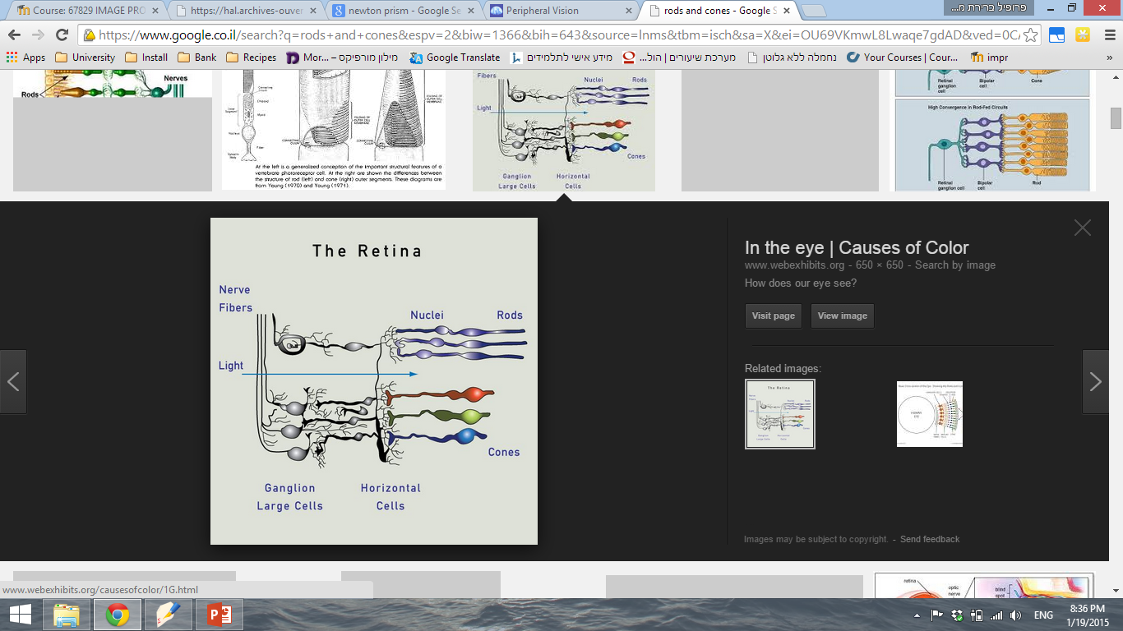
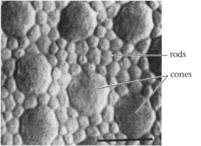
Foundations of Vision, by Brian Wandell, Sinauer Assoc., 1995

Slide 49
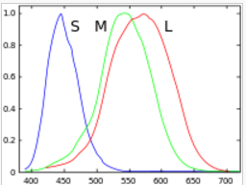
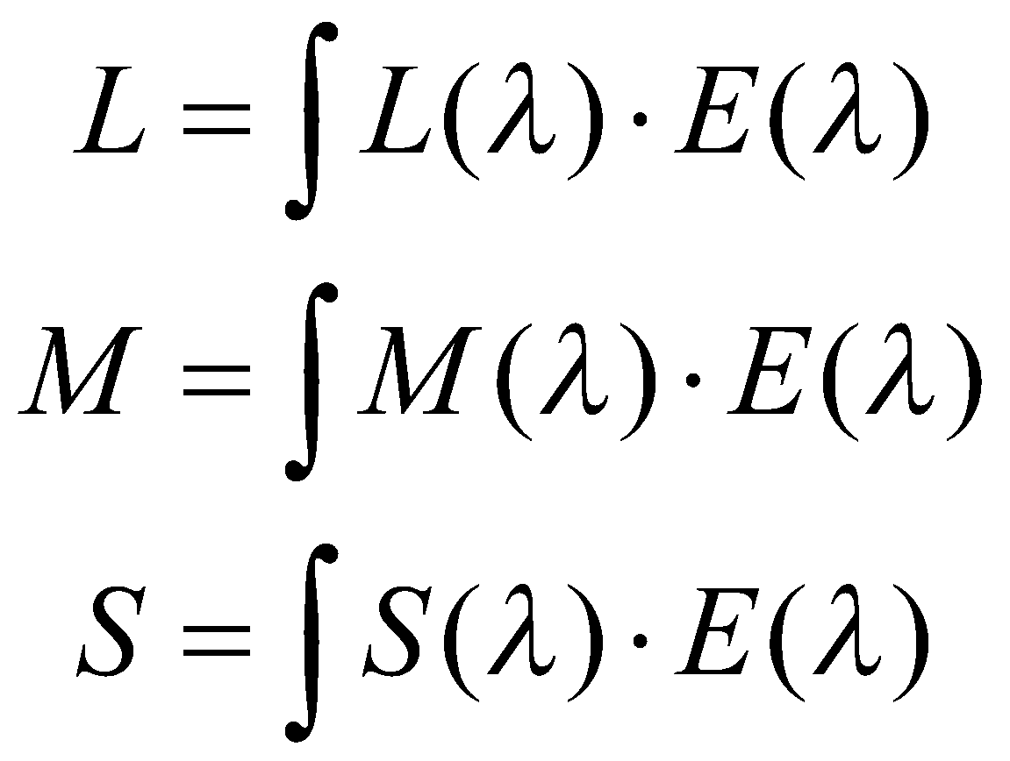
Human Color Vision
There are 3 types of light sensitive pigments in our cones (L,M,S), each having a different spectral response curve.
© Pat Hanrahan.
Biological basis of most types of color blindness.

Slide 50
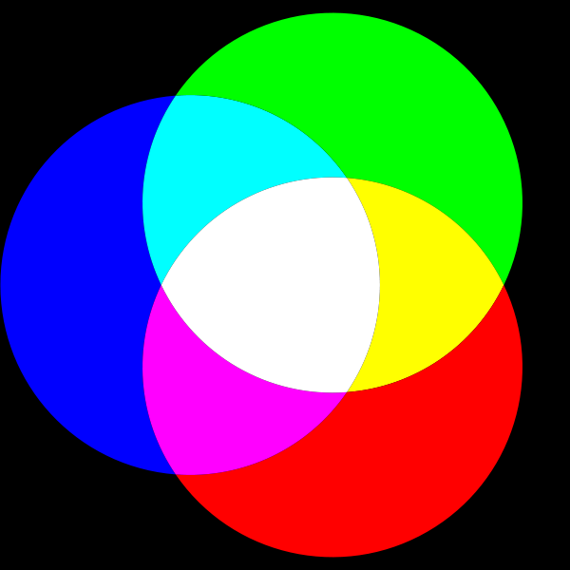
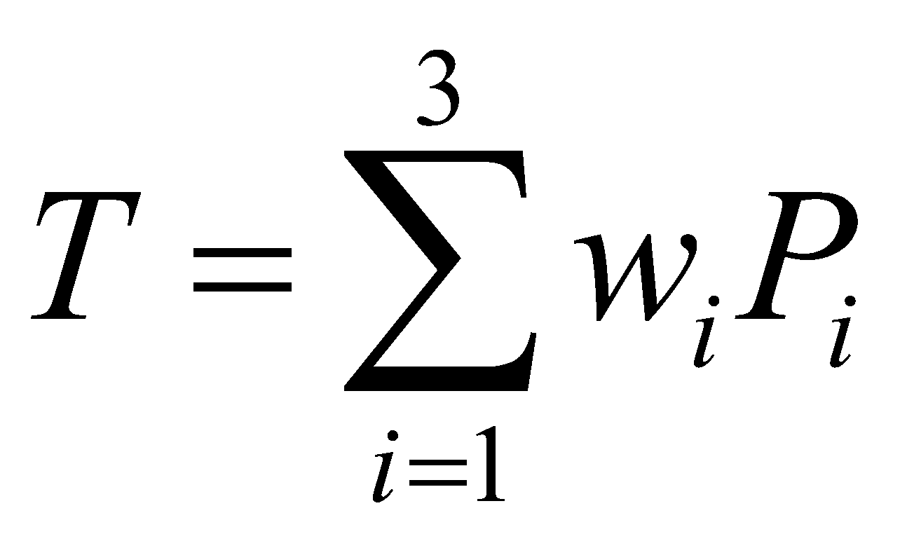
Principle of Trichromacy (Young-Helmholtz theory 1802)
Color matching experiments show that for a typical person no more than three spectra are required to reproduce all perceived colors
Where P_{i} - primary colors, and w_{i} – weights.
Example: P1 = 645nm (R), P2 = 526nm (G), P3 =444nm (B)

Slide 51
Color matching is linear
Grassman’s Laws (1853)
Color matching is additive:
C₁+C₂ = (R₁+R₂) + (G₁+G₂) + (B₁+B₂)
Scaling the color and the primaries by the same factor preserves the match:
αC = αR + αG + αB
These statements are true as any biological law. They mean that people behave like linear systems in the color matching experiment.

Slide 52
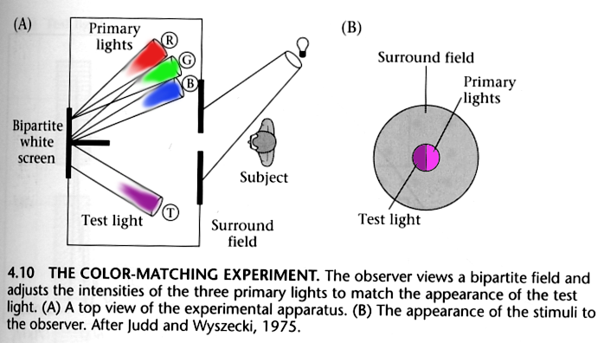
Color matching experiment
Foundations of Vision, by Brian Wandell, Sinauer Assoc., 1995

Slide 53
Color matching experiment 1

Slide 54
Color matching experiment 1
p₁ p₂ p₃

Slide 55
Color matching experiment 1
p₁ p₂ p₃

Slide 56
Color matching experiment 1
The primary color amounts needed for a match
p₁ p₂ p₃

Slide 57
Color matching experiment 2

Slide 58
Color matching experiment 2
p₁ p₂ p₃

Slide 59
Color matching experiment 2
p₁ p₂ p₃

Slide 60
Color matching experiment 2
Adding a “negative” amount of p₂ to the test color’s side:
The primary color amounts needed for a match:
p₁ p₂ p₃
p₁ p₂ p₃
p₁ p₂ p₃

Slide 61
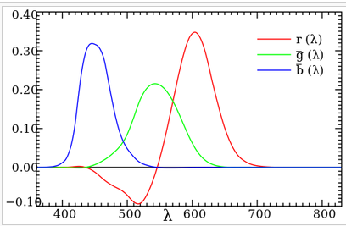
Spectral matching functions
Red, Green and Blue primaries.
Match each pure color in the visible spectrum with the 3 primaries, and record the values of the three as a function of wavelength.
Note: We need to specify a negative amount
of primary to represent all colors.
© Pat Hanrahan.

Slide 62
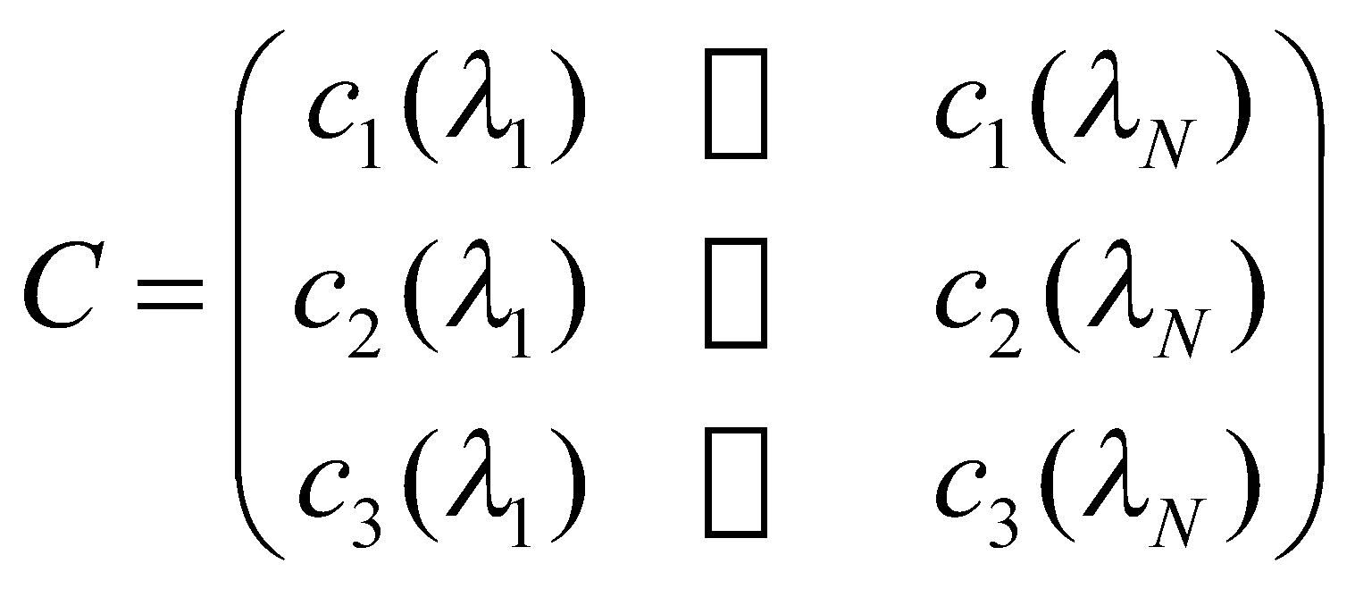
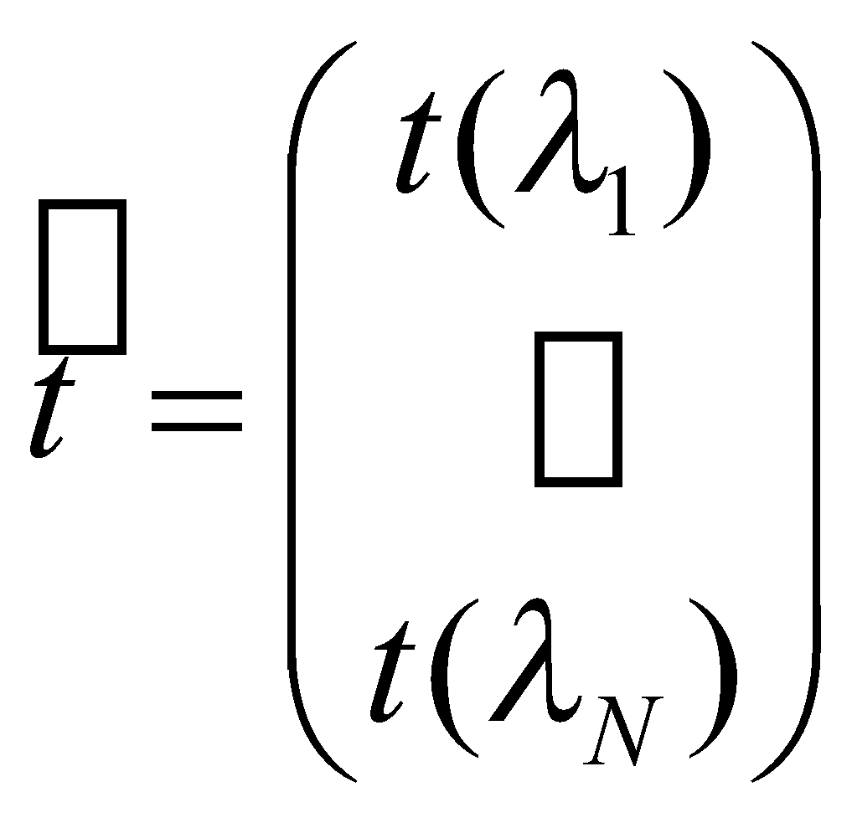

Color matching functions - discrete
In general:
…
…
...
Let the spectral signal be described by the vector t.
...
Then the amounts of each primary needed to match t are:

Slide 63
Color metamerism
Two spectra, t and s, perceptually match, if
Ct = Cs
Where C is the Color Matching Functions of a set of primaries

Slide 64
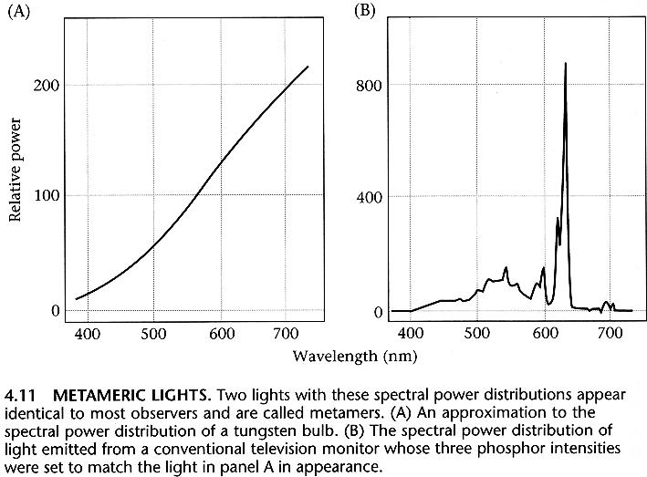
Color metamerism

Slide 65
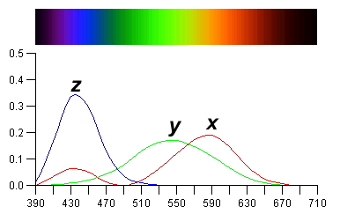
CIE-XYZ Color Space
For only positive mixing coefficients, the CIE (Commission Internationale d’Eclairage) defined 3 new hypothetical light sources X, Y and Z (as shown) to replace red, green and blue.

Slide 66
Sample: RGB ←→ XYZ
[ R ] [ 3.240479 -1.537150 -0.498535 ] [ X ] [ G ] = [ -0.969256 1.875992 0.041556 ] * [ Y ] [ B ] [ 0.055648 -0.204043 1.057311 ] [ Z ]
Not all XYZ colors have positive RGB values
[ X ] [ 0.412453 0.357580 0.180423 ] [ R ] [ Y ] = [ 0.212671 0.715160 0.072169 ] * [ G ] [ Z ] [ 0.019334 0.119193 0.950227 ] [ B ]
All positive RGB values have positive XYZ values
Notes:
66

Slide 67
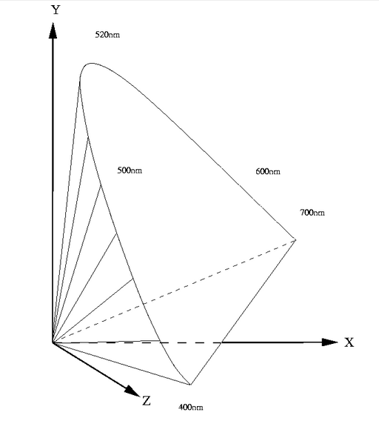
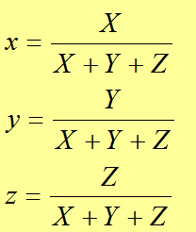
CIE-XYZ Color Space
Often convenient to work in 2D color space, so 3D color space projected onto the plane (X+Y+Z=1) to yield the chromaticity diagram.

Slide 68
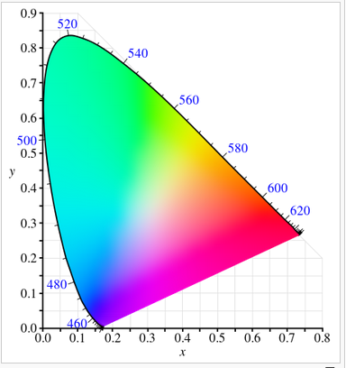
CIE-xy Chromaticity Diagram
Three Imaginary colors X-Y-Z
All weights are positive
Represents all visible colors
(gamut of human vision)
Colors are additive
The weights X, Y, Z form the
3D CIE-XYZ space.
Notes:
68

Slide 69
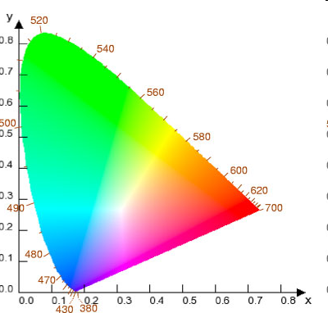
CIE-xy Chromaticity Diagram
C is “white”
A and B can be mixed to produce any color along the line AB here including white.
The same as for EF (no white this time).
The same as for ijk (includes white)
E
F
D
i
B
C
j
A
k

Slide 70
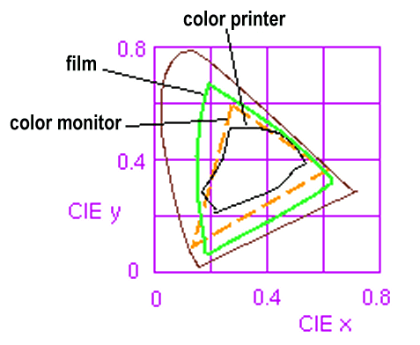
Some device color “gamuts”
The diagram can be used to compare the gamuts of various devices. Note particularly that a color printer can’t reproduce all the colors of a color monitor. Note no triangle can cover all of visible space.
C

Slide 71
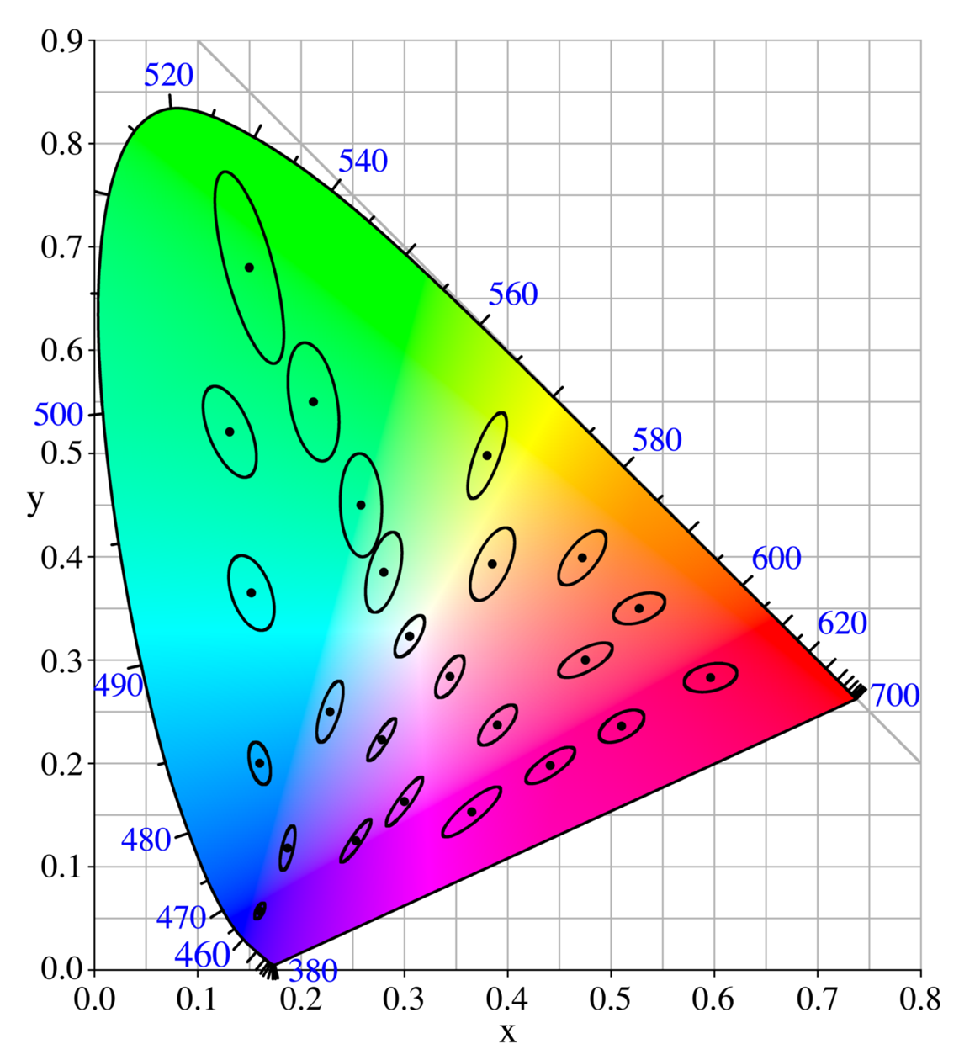
MacAdam Ellipses
Notes:
71

Slide 72
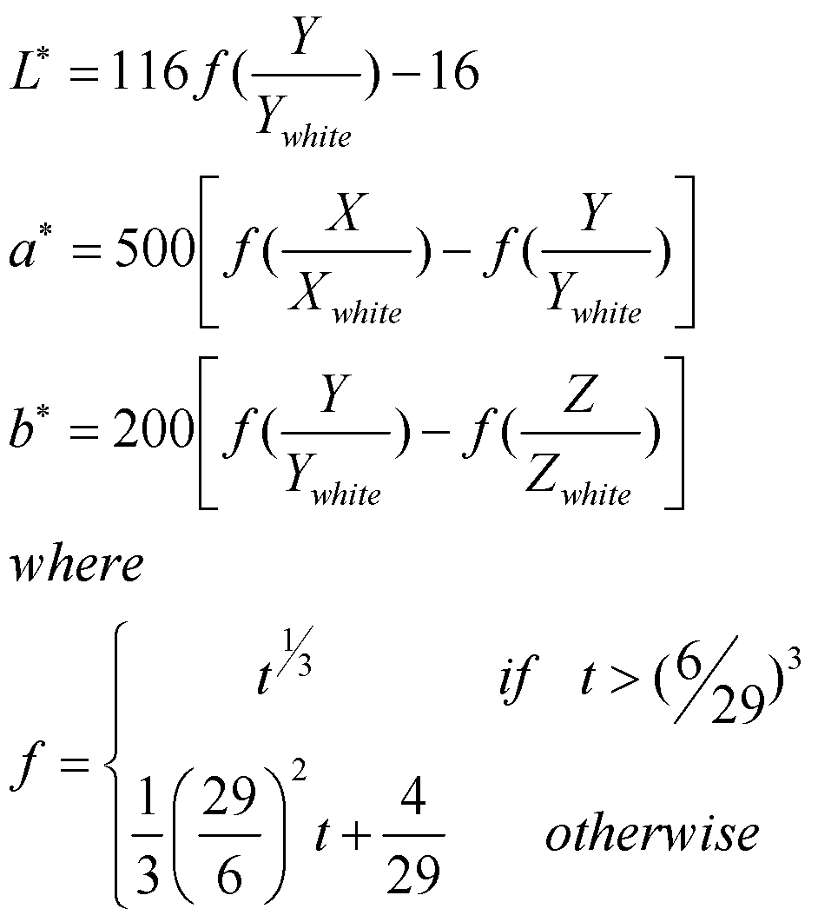
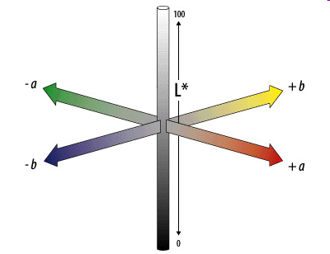
CIE-Lab Color Space
L represents the luminance (L = Y^{1/3});
a,b contain the color information (chromaticity)
Euclidian distance in this space approximates the relative perceptual color change locally.
Common variant: CIE-L*a*b* (1976)

Slide 73
Luminance
Compare color source to a grey source
Luminance: Y = 0.30R + 0.59G + 0.11B
Perceptual measure – Brightness: L* = Y ^{1/3}

Slide 74
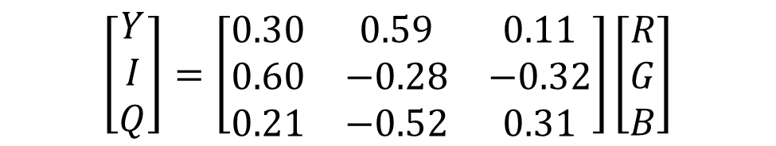
The YIQ & YUV Color Models
Recoded RGB for transmission efficiency, compatibility with B/W broadcast TV
Y = CIE’s Y (luminance); I,Q encode chromaticity

Slide 75


RGB drawbacks
Humans: chromaticity (hue, saturation) and luminance
(80,10,10)
(10,80,80)
(240,20,20)

Slide 76

The Color Cube
R,G,B model is additive, i.e. we add amounts of 3 primaries to get required color.
Visualizing RGB space as a cube, grey values occur on diagonal K to W.

Slide 77


Rotating the Color Cube
blue
cyan
green
yellow
magenta
cyan
red
green
red
yellow
blue
magenta
Notes:
77

Slide 78

HSV Color Space
Hue – the color of the pure pigment.
Saturation – measure of colorfulness (distance from the gray line).
Value – measure of brightness.
Maximum saturation occurs when V=1.
If V = 0 , H is undefined.

Slide 79

CMYK – a subtractive color model
A computer monitor mixes shades of red, green, and blue to create color pictures. White – adding the three primaries
A CMYK printer instead uses light-absorbing cyan, magenta and yellow inks. White – natural color of background

Slide 80
Lots of color spaces
CIE - XYZ
CIE - L*a*b*
CIE - RGB
HSV
CMY, CMYK
YUV, YIQ…
Black – Linear Red - Nonlinear
Notes:
80

Slide 81
What is a color histogram?
Density function, usually R³ → R
The value of bin B _{(ri, gi, bi)} (in an RGB color histogram) is the number of image pixels having RGB values equal to [r_{i},g_{i},b_{i}]
Notes:
81

Slide 82
Properties of color histograms
Assuming an 8-bit depth RGB image, the RGB histogram has 256³ = 16777216 bins, which means it is usually very sparse.
A natural image property that contributes to the sparseness of color histograms is the “piecewise smooth world” property.
Notes:
82

Slide 83




Properties of color histograms
The histogram is sparse, with most of its values located in a small volume of the RGB cube
Notes:
83

Slide 84


Color Histogram
Suppose we want to find images that are similar to a query image
Comparing pixel values is extremely sensitive to changes in the image…
Comparing color histograms is much more robust since we are only comparing the “color palette”
Notes:
84

Slide 85


Color Histogram
Different ways of calculating the distance between two histograms:
Euclidean distance
Intersection score
EMD - “Earth Mover’s Distance”
Notes:
85

